Slide 1

NSC Senior Surfers Computer Club Orientation

Slide 2
Roadmap
Resources for all Senior Center Members
Additional Resources for Senior Surfer Members
A Tour of our Lab & Website
Notes:
Have everyone log in to Senior Surfers and Windows 7

Slide 3
Resources for All Senior Center Members
Open Computer Lab Hours
Mondays 11:30 – 1
Tuesdays 10 – 12
Wednesdays 12:30 – 2
Weekly Technology Presentations
Thursdays 1 – 2:30 in classroom across the hall from the lab
Topics are listed in the NSC Newsletter (but may change)
Last Thursday of the month: Apple
Notes:
Have everyone log in to Senior Surfers and Windows 7

Slide 4
2 Public Computers in the Center Library
Wifi Internet connections for your personal laptops or tablets (ask for the password at the main desk)
Website
Veteran’s Gallery
Free Class: Surfers Club Orientation (several times a year)
Notes:
Have everyone log in to Senior Surfers and Windows 7

Slide 5
Resources for Senior Surfers Club Members
Membership: $5/year
One-on-one Help Sessions
Mondays 1 – 4
(Thursdays 2:30 – 4)
President’s Weekly e-mail Newsletter
Upcoming events, volunteer opportunities, board info
Notes:
Have everyone log in to Senior Surfers and Windows 7

Slide 6
e-mail Notifications of Upcoming Events & Classes
Special-Interest Groups
Genealogy
Lab Research (1st Wednesday at 10 am)
Discussion Group (4th Wednesday 10 am)
Apple Users Group
Last Thursday of the month, 1 – 2:30
Photography (TBA)
Notes:
Have everyone log in to Senior Surfers and Windows 7

Slide 7
Pot-luck Socials twice a year in the Fall & Spring
Volunteer Opportunities
Free Beginner’s Class (once a month)
Basic computer operation, terminology & navigation
One-on-one help based on personal needs & interests
Notes:
Have everyone log in to Senior Surfers and Windows 7

Slide 8
Hands-on Classes
notification & registration by e-mail; $5 due on day of class
Some recent classes:
Microsoft Office Programs: Word, Excel, Powerpoint
Beginner’s Class: Intro to the Computer
Working with the Mouse or Windows
File Management I and 2
Gmail and other Google programs
Computer Maintenance I & II
Notes:
Have everyone log in to Senior Surfers and Windows 7

Slide 9
Resources in the Lab
Computers: Apple & PC
Printers, Copiers & Scanners
Specialized Hardware & Software

Slide 10
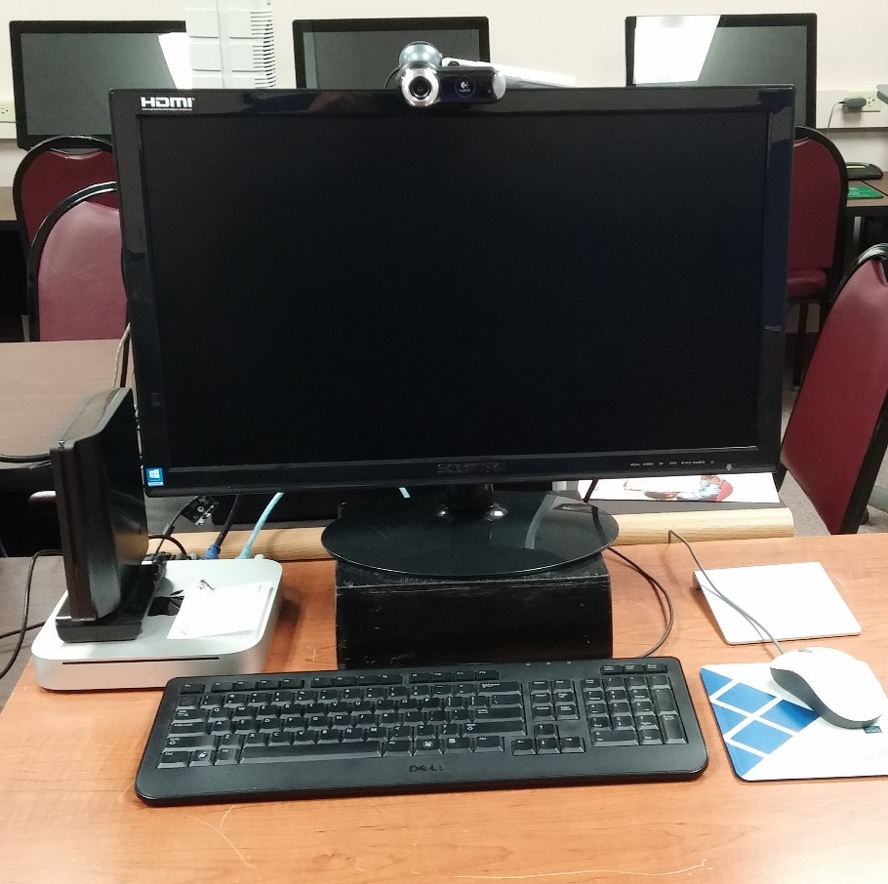
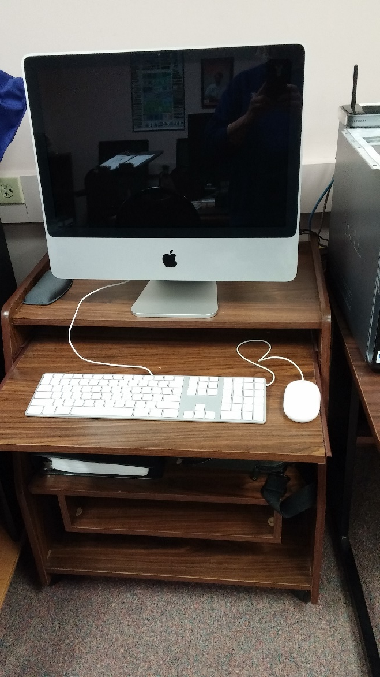
Apple Computers
Mac Mini
Running Sierra Operating System (most recent)
iMac
Running Yosemite Operating System

Slide 11
PC’s (Windows Computers)
Boot to Windows 7 or Windows 10
High-speed direct Internet access
Touch-sensitive screens
Optical mice
USB slots
Headphone Jacks or Speakers (please keep volume low)

Slide 12
Most
Read and write DVDs and CDs
have memory card slots
Some have additional devices and/or software

Slide 13
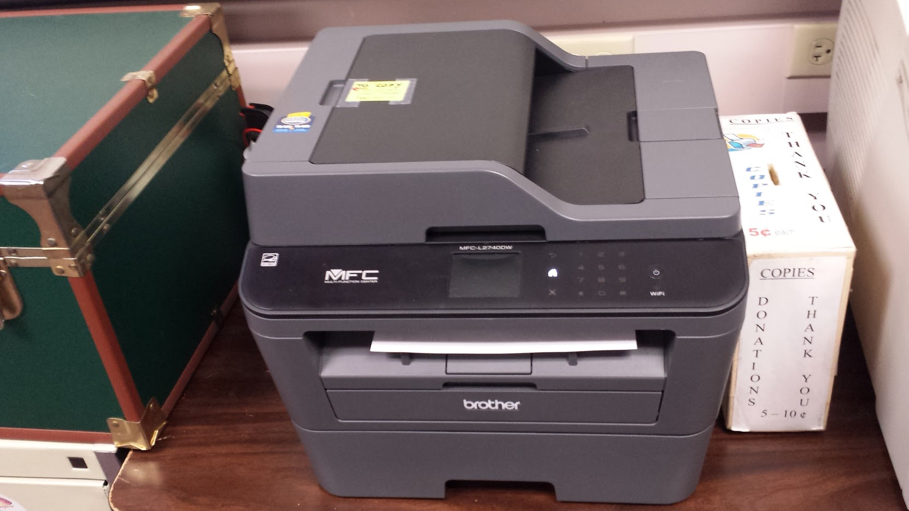
Printer/copier/scanner
Brother MFC-L2740DWB&W printer/scanner/copier
5¢/page requested
PLEASE limit printing or copying to a few copies at a time

Slide 14
Resources for Converting Old Media to New
Some lab computers have specialized hardware and software for converting old media like video tapes, cassette tapes, lp’s, photos, negatives and slides to digital format
Basic instructions are available, but we encourage first-time users to make an appointment for one-on-one help

Slide 15
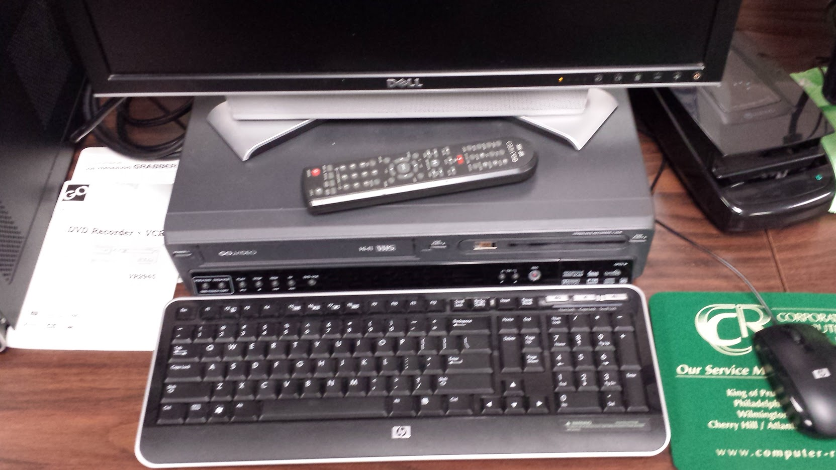
Converting VHS Tapes to Digital Format
Burning VIDEOS to DVD

Slide 16
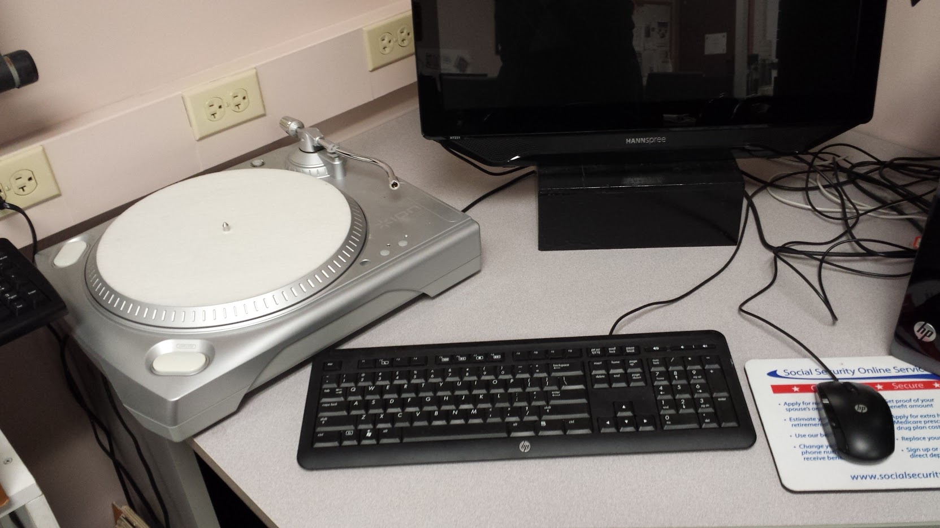
Converting LP’s to Digital Files like MP3

Slide 17
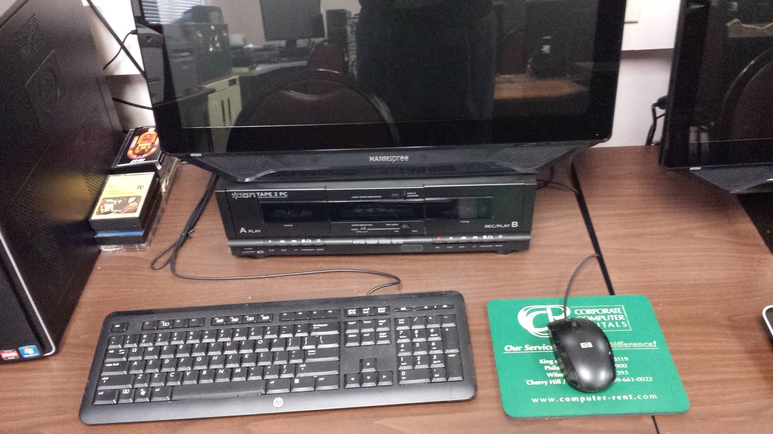
Converting Cassette Tapes to Digital Format like MP3

Slide 18
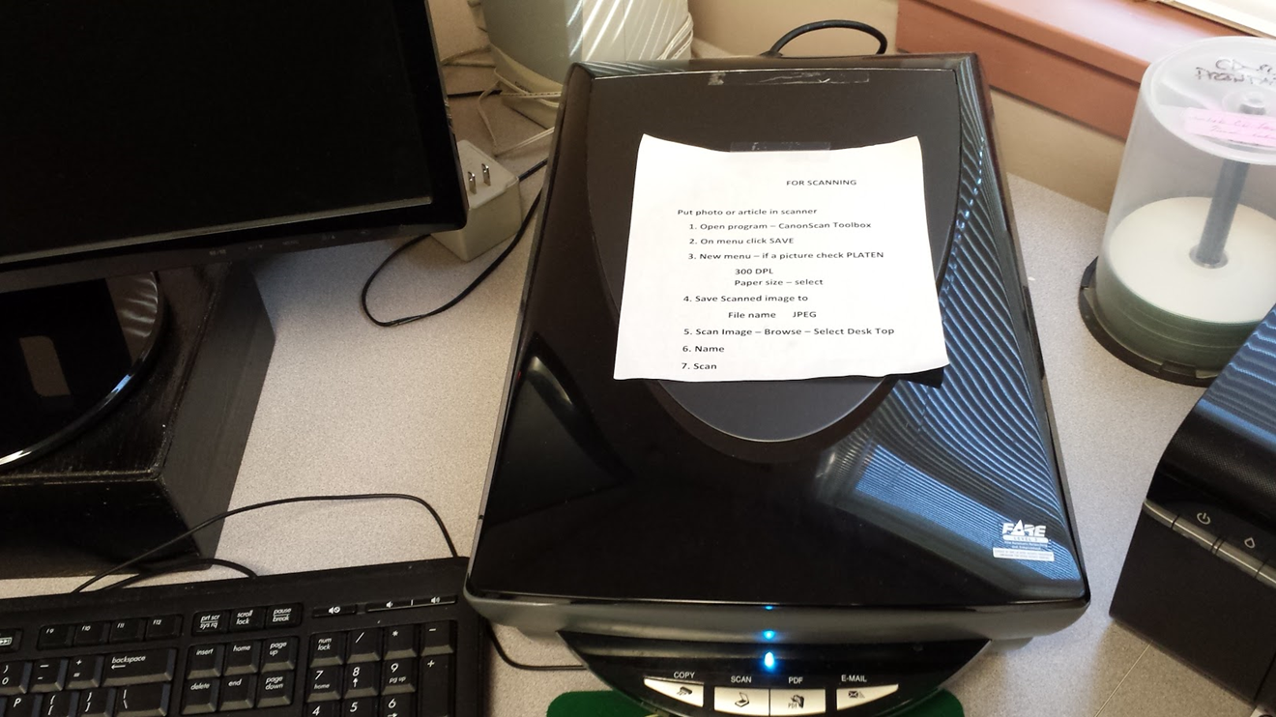
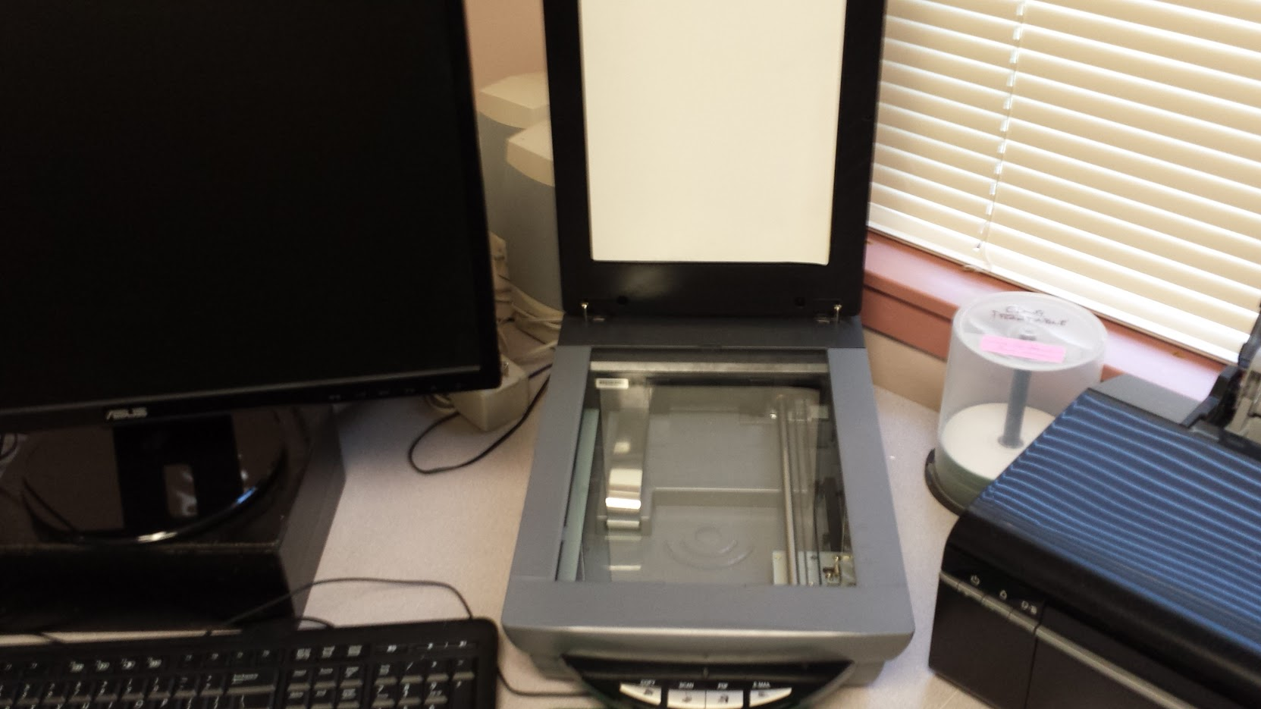
Converting Documents, Photos, Slides & Negatives to Digital Files
The Brother printer can also be used to scan black & white/color documents & photos ONLY

Slide 19
Additional Hardware
Wolverine stand-alone slide scanner
External 3-1/5” Floppy drive w/USB connection
External CD-RW drive w/USB connection
A limited number of flash/thumb drives for purchase

Slide 20
Loaner “Try-B-4-U-Buy” Devices
A variety of mobile devices are available to borrow, for ex:
  ChromeBook, Samsung C12, Apple iPad with Retina display (Gen 4), Windows 8 2-in-1 Tablet/Laptop, Asus T100ta-c1-gr(s), Nexus 9 Tablet, HTC Nexus 9, Nook eReader, Barnes & Noble Nook Model BNRZ100
Normal loan is one week.
To Reserve:
Email nscsurfers@gmail.com OR Fill in contact form on the support tab of our webpage OR Ask Bob on a Monday or Thursday afternoon
Notes:
Have everyone log in to Senior Surfers and Windows 7

Slide 21
Software
Internet Browsers (Edge, Chrome, Firefox)
Microsoft Office Programs (Word, Excel, Powerpoint)
Photoshop Elements (Photo & Video Editing)
ProShow Gold (Presentation software)
Free access to Ancestry.com
Free software to try, like iTunes, VLC, Picasa, IrfanView, LibreOffice, DVDStyler, PDF Creator, Malwarebytes, CDBurnerXP, Nero, Power2Go, 7-Zip, Ccleaner
Notes:
These are all expensive if bought for your personal PC’s but free to use in the computer lab.

Slide 22
Using the Lab
Please DO
Report any problems/issues to the monitor or instructor
Remember to log out of your e-mail account before you leave
Bring your own flash drive, CD/DVD, or headphones according to your goal in the lab
Please DON’T
Eat or drink around computers
Change settings on your computer or try to download programs without first checking with the lab monitor
Leave your personal files on our computers (save them on your flash drive or move them there before you leave)

Slide 23
Using Your Own Laptop or Tablet
A table is available in the center of the lab with power strips and Ethernet cables
To connect to the Internet, you can
  Plug in an Ethernet cable (looks like a large phone jack) OR
  Connect to our wireless network (NSC-WiFi)
  Password: NSC-wifi2014
Notes:
Have everyone log in to Senior Surfers and Windows 7

Slide 24
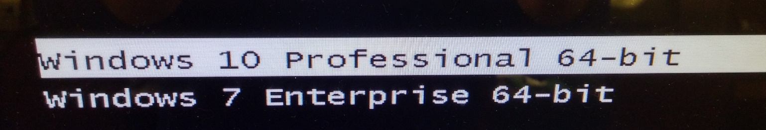
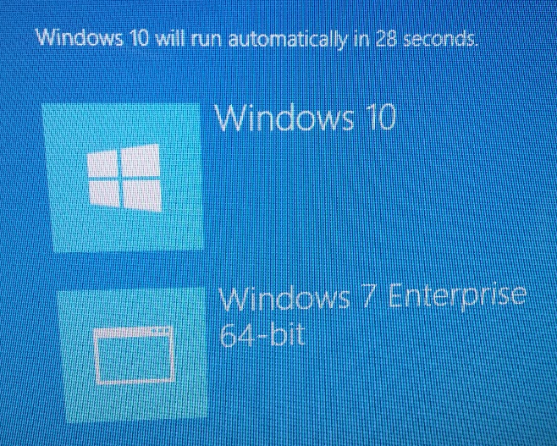
Booting Lab Computers to Windows 7 or 10
By default (if you do nothing), computers will boot to Windows 10
To use Windows 7, as the computer starts,
If you see text, use the down arrow key on the keyboard to highlight Windows 7, then press the ENTER key
If you see boxes, tap Windows 7 on the screen – or point the cursor at Windows 7 and click the left mouse button
Notes:
Have everyone log in to Senior Surfers and Windows 7

Slide 25
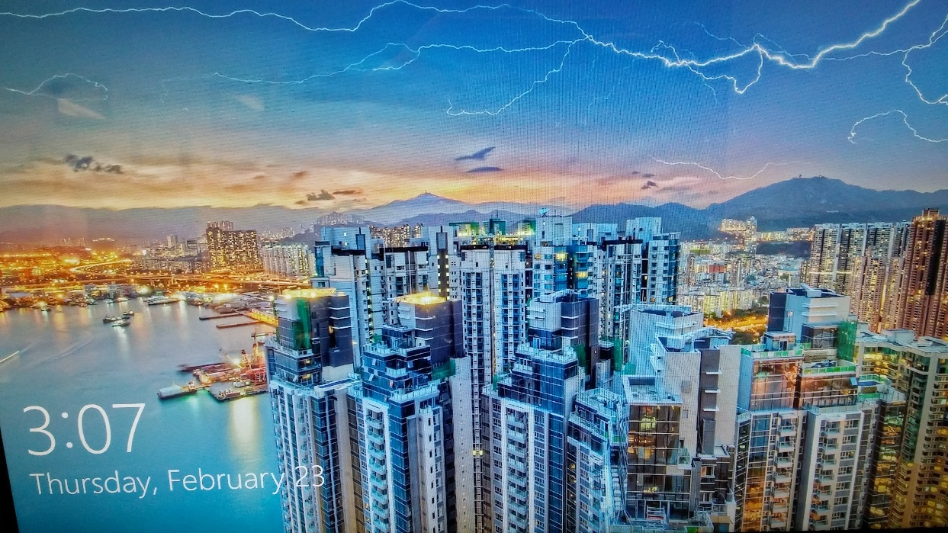
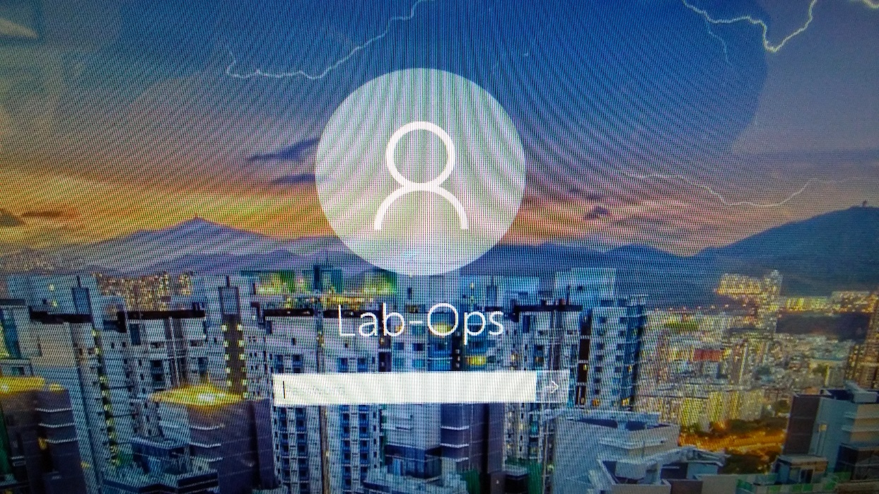
Logging in to Lab Computers
In Windows 10, when you see the first screen (the “lock screen”), press any key to open the Log-in Screen
Notes:
Have everyone log in to Senior Surfers and Windows 7

Slide 26
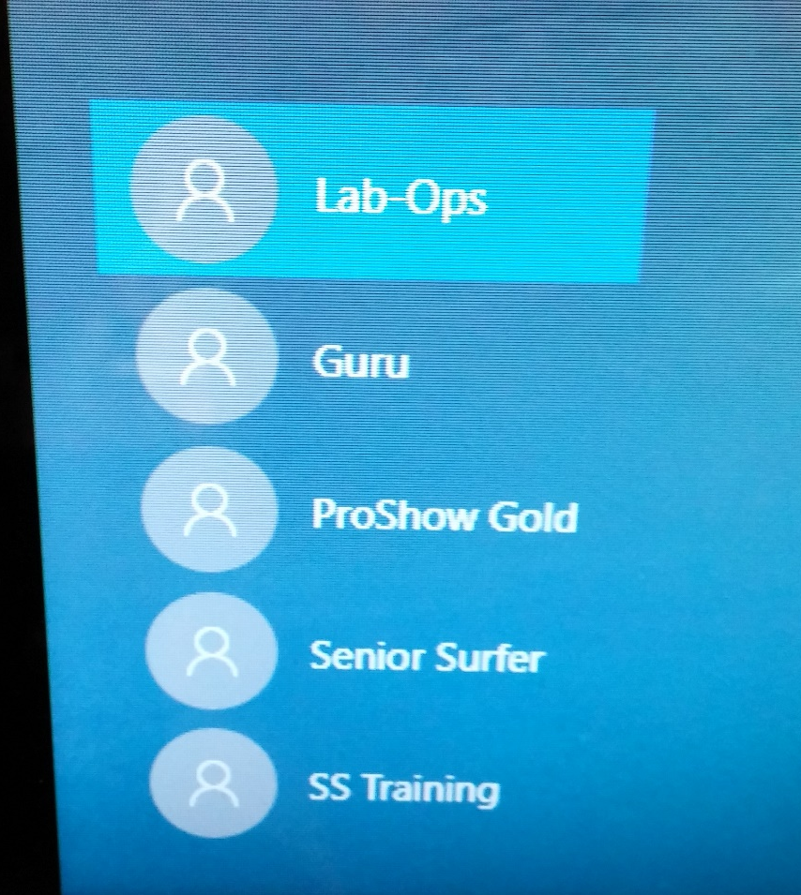
SELECT THE SENIOR SURFER ACCOUNT
If Senior Surfer is not selected, click or tap on that icon
Notes:
Have everyone log in to Senior Surfers and Windows 7

Slide 27
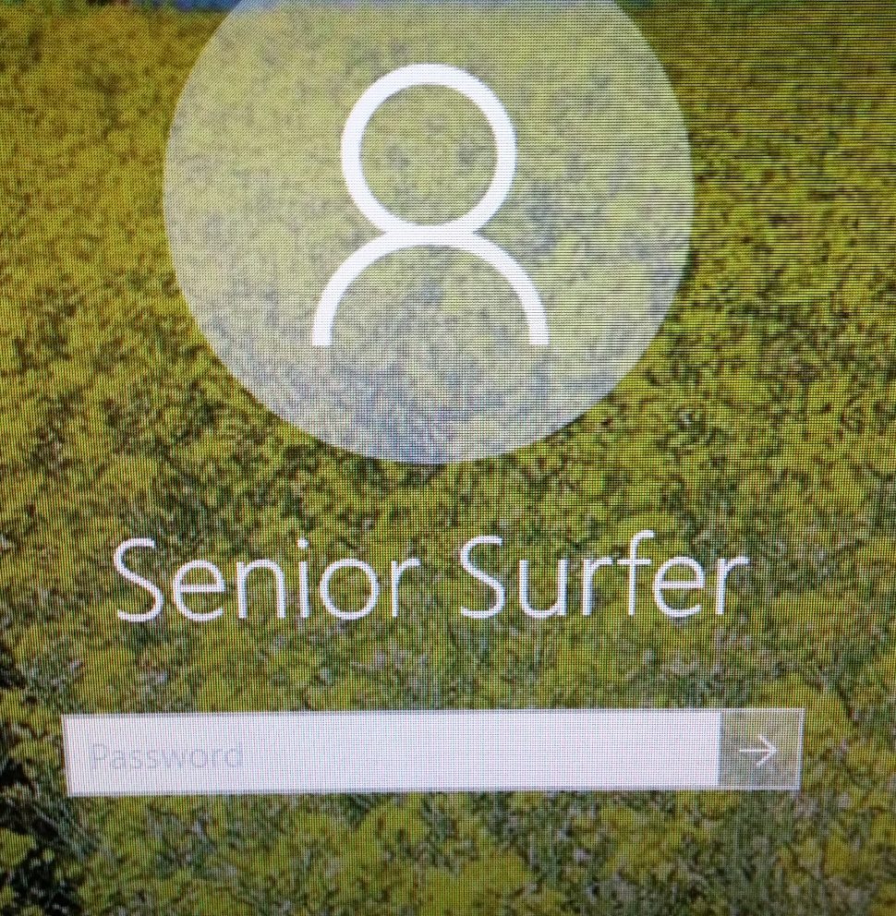
ENTER THE SENIOR SURFER PASSWORD
Click in the box marked password
Type the word senior
Press the ENTER key on the keyboard OR click (or tap) on the arrow next to the password box
Notes:
Have everyone log in to Senior Surfers and Windows 7

Slide 28
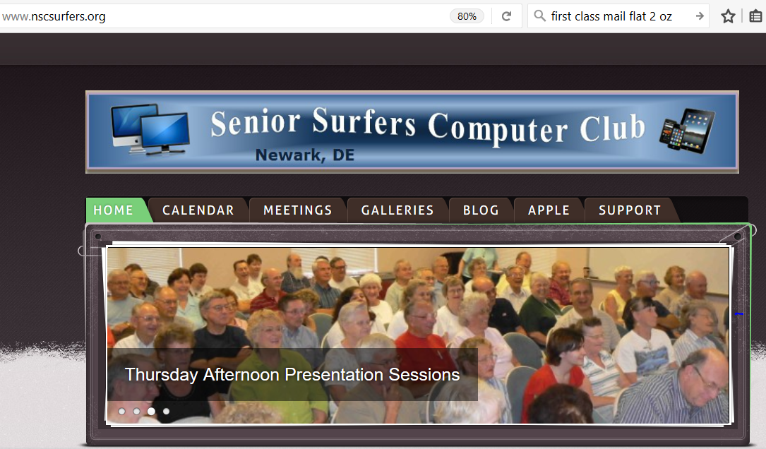
Our Website: nscsurfers.org

Slide 29
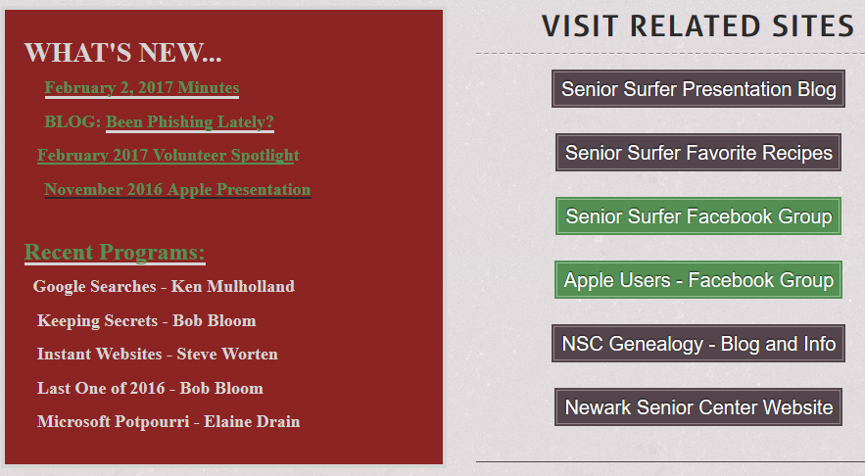
Home Page
Links to recent postings, programs, special interest group activities

Slide 30
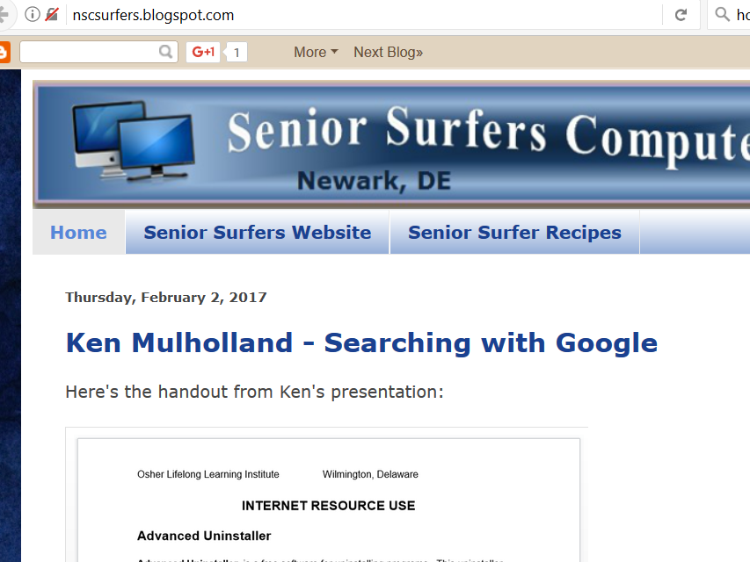
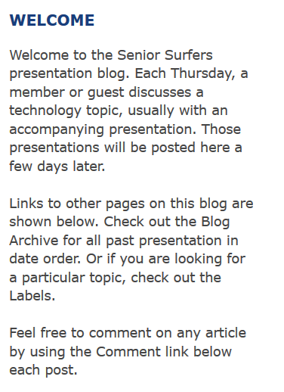
Thursday Presentation Blog

Slide 31
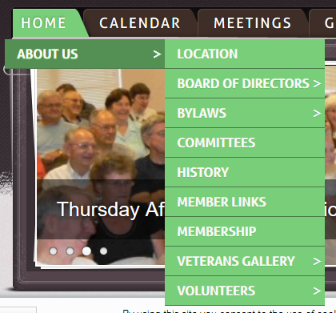
HOME TAB: About Us

Slide 32

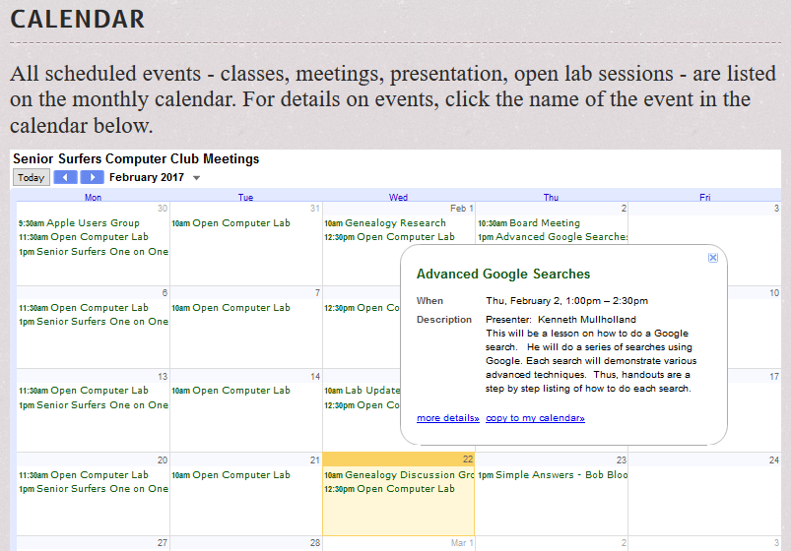
CALENDAR TAB
Click on the right arrowhead to see the next month
Click on a calendar entry for more info

Slide 33
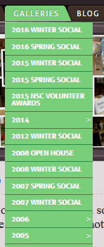
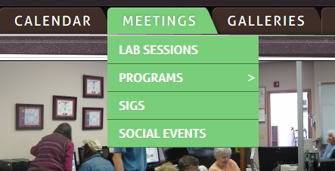
MEETINGS & GALLERIES TABS

Slide 34
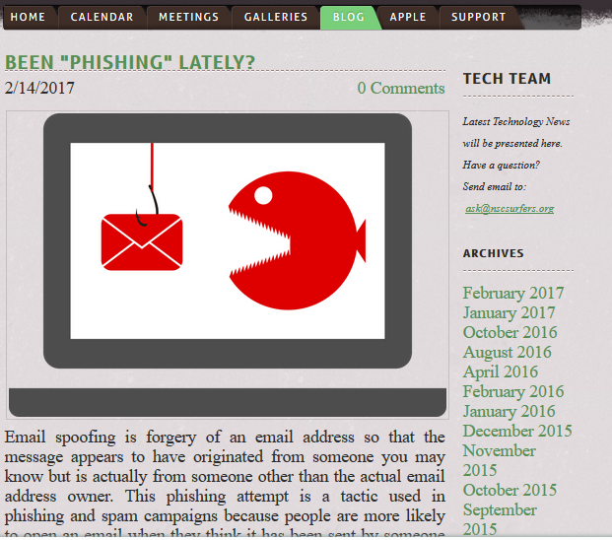
BLOG TAB

Slide 35
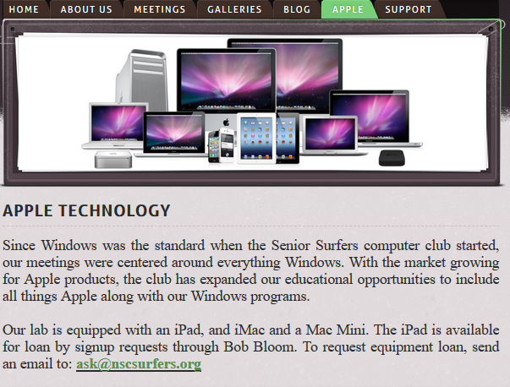
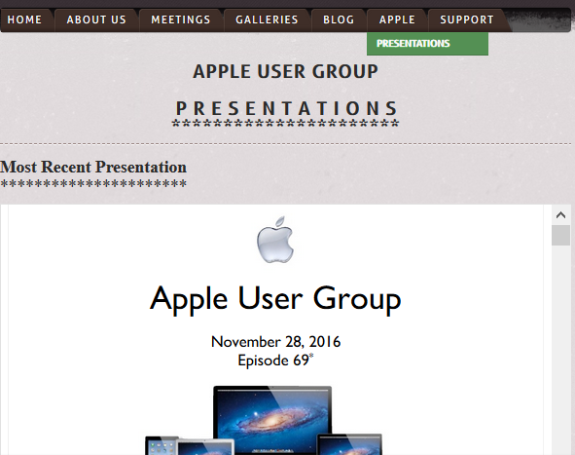
APPLE TAB

Slide 36
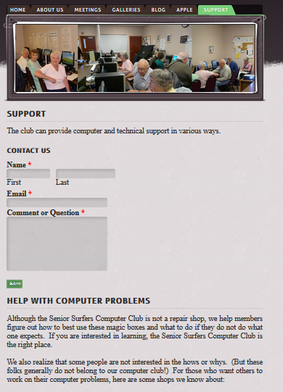

SUPPORT TAB: Contact Us

Slide 37
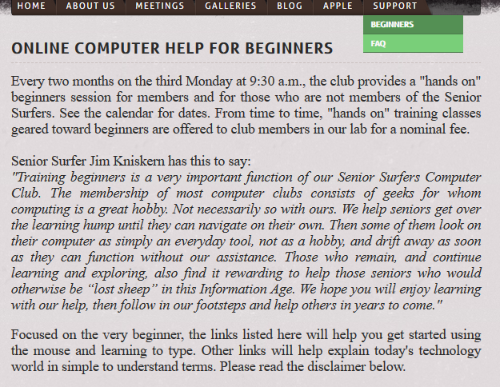
SUPPORT TAB: Help for Beginners

Slide 38
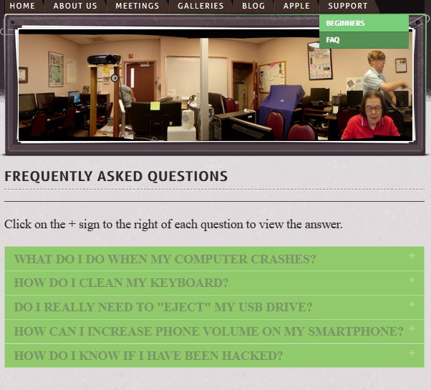
SUPPORT TAB: Frequently Asked Questions

Slide 39
YOUR QUESTIONS? COMMENTS?

Slide 40
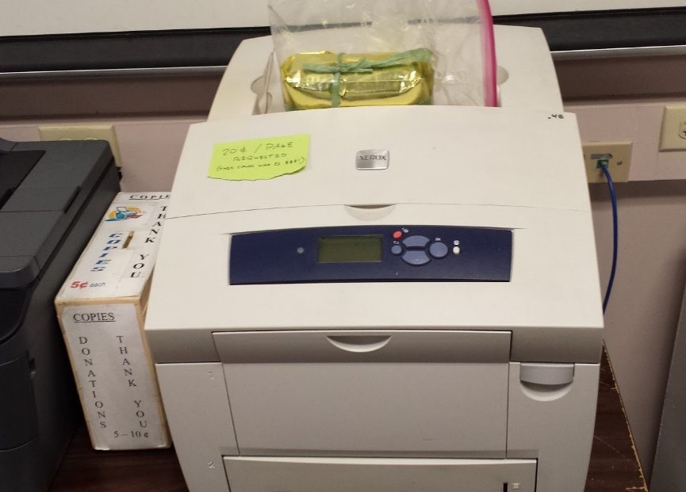
Xerox Phaser 8560: high quality color printing
20¢/page requested
PLEASE ASK FOR HELP BEFORE USING
For very limited use
Must be turned on & allowed to warm up

Slide 41
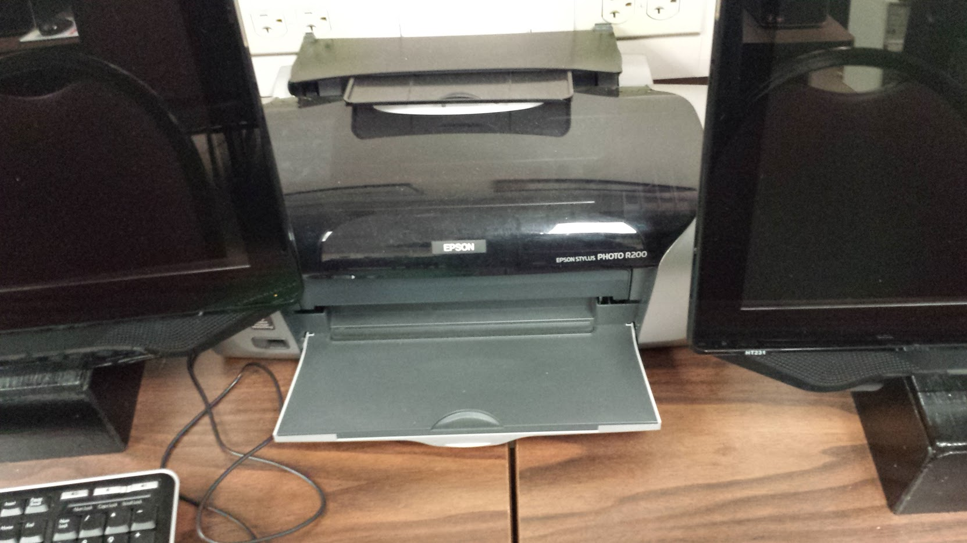
Epson Artisan 50
with CD/DVD printing attachment

